Slide 1
PHISHING AWARENESS TRAINING
BY- Alpana Mishra

Slide 2
Introduction to Phishing
Phishing is a fraudulent attempt to obtain sensitive information such as usernames, passwords, or credit card details by pretending to be a trustworthy entity in electronic communications.

Slide 3
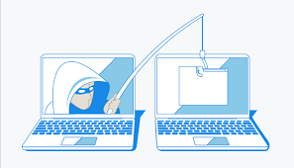
Types of Phishing Attacks
1.Email Phishing:
Description: Fake emails that appear to be from legitimate organizations.
Example: Emails requesting you to verify account details or click on malicious links.

Slide 4
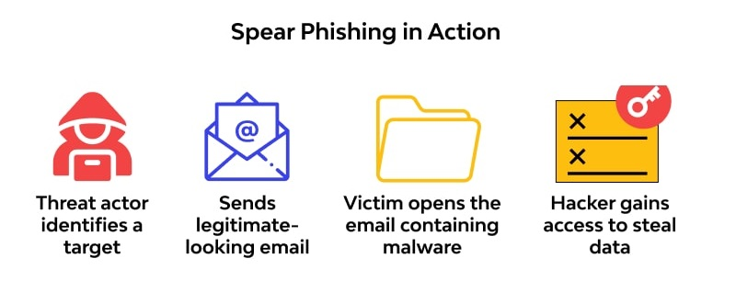
Spear Phishing:
Description: Targeted attacks aimed at specific individuals or organizations.
Example: Emails that reference personal information or recent activities.

Slide 5
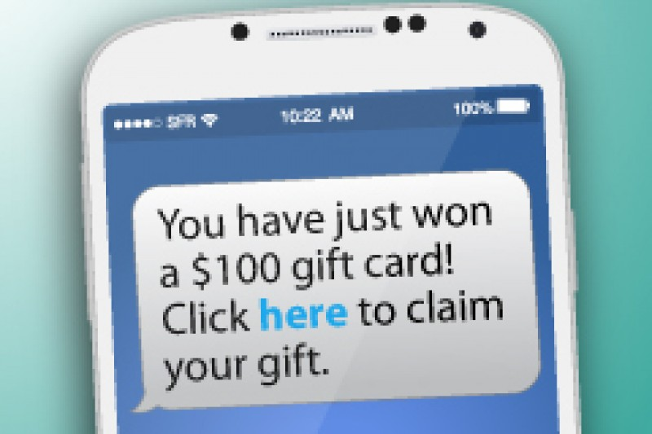
Smishing (SMS Phishing)
Description: Phishing attacks conducted via text messages.
Example: Texts that prompt you to click on a link or provide personal information.

Slide 6
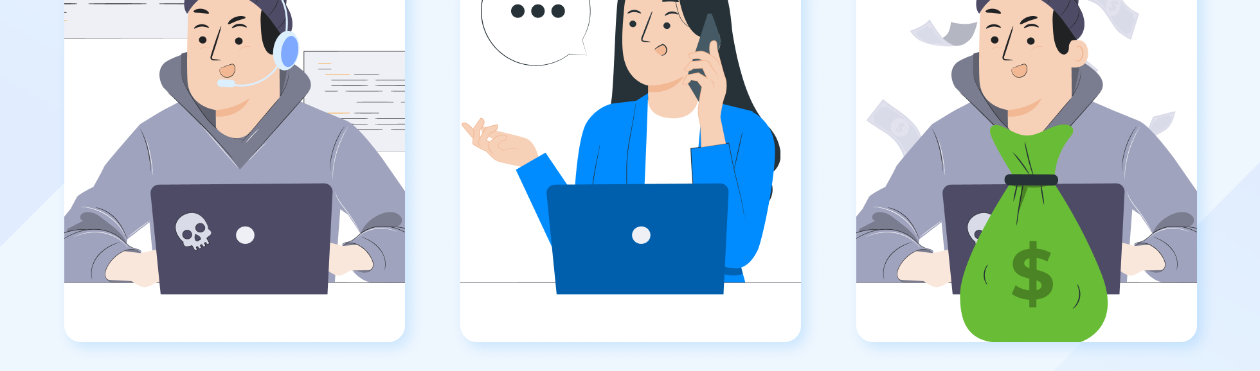
Vishing (Voice Phishing)
Description: Fraudulent phone calls attempting to gather personal information.
Example: Calls from supposed bank representatives asking for account details.

Slide 7
Recognizing Phishing Emails
Signs of Phishing Emails:
Suspicious Sender: Email addresses that don’t match the sender’s domain.
Urgent Language: Requests for immediate action or threats of account suspension.
Spelling and Grammar Mistakes: Poorly written emails with errors.
Unusual Links: Hover over links to check if they lead to legitimate websites.
Attachments: Unexpected or unusual attachments.

Slide 8
Identifying Phishing Websites
Signs of Phishing Websites:
URL Check: Look for misspellings or unusual domains.
SSL Certificate: Check for HTTPS and a padlock symbol in the address bar.
Website Design: Poorly designed websites that don’t match the legitimate site’s appearance.

Slide 9
Social Engineering Tactics
What is Social Engineering?
Manipulating people into divulging confidential information or performing certain actions.
Common Tactics:
Pretexting: Creating a fabricated scenario to obtain information.
Baiting: Offering something enticing to lure victims into a trap.
Impersonation: Pretending to be someone trusted to gain access to information.

Slide 10
How to Avoid Phishing Attacks
1.Email Security:
Verify Sources: Double-check email addresses and links.
Use Spam Filters: Enable spam and phishing filters.
Avoid Clicking: Don’t click on suspicious links or download attachments from unknown sources.

Slide 11
2.Website Security:
Verify URLs: Always verify the URL before entering sensitive information.
Use Password Managers: To store and generate strong, unique passwords.

Slide 12
3. Personal Security
Educate Yourself: Stay informed about the latest phishing tactics.
Report Suspicious Activity: Notify your IT department or service provider if you suspect a phishing attempt.

Slide 13
Real-Life Examples and Case Studies
Example 1: A notable phishing scam targeting financial institutions.
Example 2: A case where personal data was compromised due to a phishing attack.
Lessons Learned: How these cases were handled and what could have been done to prevent them.

Slide 14
Conclusion
In this presentation we learned about phishing ,their types and how to tackel them and Educated others about recognizing and avoiding phishing emails, websites, and social engineering tactics

Slide 15


